Slide 1
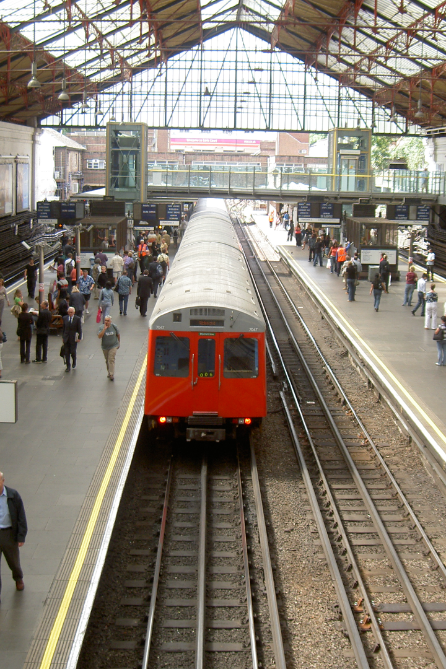

Application of Queue Data Structure in Train Ticket Booking
Discover how the powerful queue data structure is utilized in the complex and fast-paced world of train ticket booking systems.
Notes:
1

Slide 2

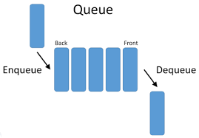
Overview of Queue Data Structure
The queue data structure is a linear collection that follows the FIFO (First-In-First-Out) principle. Elements are added to the rear and removed from the front. This structure is ideal for managing ordered operations.
Notes:
2

Slide 3

Explanation of Train Ticket Booking System
A train ticket booking system allows passengers to reserve seats, check availability, and make payments efficiently. The system operates with speed and accuracy to handle a high volume of transactions.
Notes:
3

Slide 4

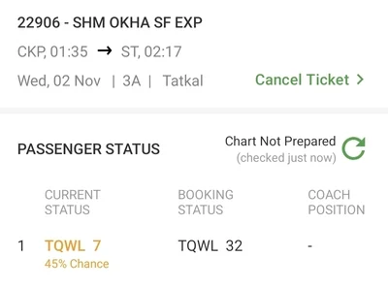
Application of Queue in Train Ticket Booking
In train ticket booking, queues play a crucial role in managing passenger requests. Each booking request joins the end of the queue and is processed in the order it was received, ensuring fairness and efficiency.
Notes:
4

Slide 5
SOURCE CODE
* C Program to Implement Ticket & Queue using Singly Linked List */
#include <stdio.h>
#include <malloc.h>
#include <string.h>
/* Node Declaration */
struct person {
char name[50];
struct person *next;
};
struct ticket {
char number[50];
struct ticket *next;
};
Notes:
4

Slide 6
struct person *create_person(char *);
struct ticket *create_ticket(char *);
void insert_person();
void insert_ticket();
void display_persons();
void display_tickets();
struct person *newperson;
struct person *ptrPerson;
struct ticket *newticket;
struct ticket *ptrTicket;
struct person *firstPerson = NULL;
struct person *lastPerson = NULL;
struct ticket *firstTicket = NULL;
struct ticket *lastTicket = NULL;
Notes:
4

Slide 7
/* Main: contains menu */
int main() {
int ch;
char ans = 'Y';
while (ans == 'Y' || ans == 'y') {
printf("\n---------------------------------\n");
printf("Operations on Ticket & Queue\n");
printf("---------------------------------\n");
printf("1. Add Person in Q\n");
printf("2. Add Ticket\n");
printf("3. Display All Persons in Q\n");
printf("4. Display All Tickets\n");
printf("10. Exit\n");
printf("~~~~~~~~~~~~~\n");
printf("Enter your choice: ");
scanf("%d", &ch);
Notes:
4

Slide 8
switch (ch) {
case 1:
printf("\n...Adding Person in Q...\n");
insert_person();
break;
case 2:
printf("\n...Adding Ticket...\n");
insert_ticket();
break;
case 3:
printf("\n...Displaying Persons in Q From Beginning to End:\n");
display_persons();
break;
case 4:
printf("\n...Displaying Tickets From Beginning to End:\n");
display_tickets();
break;
Notes:
4

Slide 9
case 5:
printf("\n...Exiting...\n");
return 0;
default:
printf("\n...Invalid Choice...\n");
break;
}
printf("\n\nDo you want to continue (Y/N)? ");
scanf(" %c", &ans);
}
return 0;
}
/* Creating Node */
struct person *create_person(char *ptrName) {
newperson = (struct person *)malloc(sizeof(struct person));
if (newperson == NULL) {
printf("\nMemory was not allocated");
return 0;
}
Notes:
4

Slide 10
else {
strcpy(newperson->name, ptrName);
newperson->next = NULL;
return newperson;
}
}
struct ticket *create_ticket(char *tktNumber) {
newticket = (struct ticket *)malloc(sizeof(struct ticket));
if (newticket == NULL) {
printf("\nMemory was not allocated");
return 0;
} else {
strcpy(newticket->number, tktNumber);
newticket->next = NULL;
return newticket;
}
}
Notes:
4

Slide 11
/* Inserting Node at Last */
void insert_person() {
char val[50];
printf("\nEnter the name of the person: ");
scanf("%s", val);
newperson = create_person(val);
if (firstPerson == lastPerson && lastPerson == NULL) {
firstPerson = lastPerson = newperson;
firstPerson->next = NULL;
lastPerson->next = NULL;
} else {
lastPerson->next = newperson;
lastPerson = newperson;
lastPerson->next = NULL;
}
printf("\n----INSERTED----");
}
Notes:
4

Slide 12
void insert_ticket() {
char val[50];
printf("\nEnter the number of the ticket: ");
scanf("%s", val);
newticket = create_ticket(val);
if (firstTicket == lastTicket && lastTicket == NULL) {
firstTicket = lastTicket = newticket;
firstTicket->next = NULL;
lastTicket->next = NULL;
} else {
lastTicket->next = newticket;
lastTicket = newticket;
lastTicket->next = NULL;
}
printf("\n----INSERTED----");
}
Notes:
4

Slide 13
/* Displays non-empty List from Beginning to End */
void display_persons() {
if (firstPerson == NULL) {
printf("No Person in the list to display\n");
} else {
for (ptrPerson = firstPerson; ptrPerson != NULL; ptrPerson = ptrPerson->next) {
printf("%s\t", ptrPerson->name);
}
}
}
void display_tickets() {
if (firstTicket == NULL) {
printf("No Ticket in the list to display\n");
} else {
for (ptrTicket = firstTicket; ptrTicket != NULL; ptrTicket = ptrTicket->next) {
printf("%s\t", ptrTicket->number);
}
}
}
Notes:
4

Slide 14
Benefits of Using Queue Data Structure
1
Efficient Resource Allocation
2
Fairness and Order
The queue ensures efficient utilization of resources by managing bookings in a systematic manner, reducing conflicts and maximizing seat capacity.
By following the FIFO principle, the queue ensures that ticket bookings are handled fairly and in the order they were made, creating a sense of order and avoiding disputes.
3
Easy to Implement
4
Scalability
The queue data structure provides a straightforward and intuitive solution, allowing for easy implementation and maintenance of the train ticket booking system.
The versatility of the queue data structure enables the system to handle a large number of booking requests, allowing the train service to scale and accommodate growing demands.
Notes:
5

Slide 15

Challenges and Considerations
Concurrency
Performance Optimization
Error Handling
Managing concurrent ticket booking requests can be challenging. Appropriate synchronization techniques and algorithms need to be implemented to ensure data integrity and prevent race conditions.
To ensure a responsive and efficient booking system, various optimization techniques such as caching, load balancing, and database indexing should be implemented.
Handling ticket reservation failures, network issues, and system errors gracefully is crucial for a reliable and user-friendly ticket booking system.
Notes:
6

Slide 16

Conclusion
The application of the queue data structure revolutionizes the efficiency and reliability of train ticket booking systems. This robust approach ensures fair and orderly handling of bookings, leading to enhanced customer satisfaction and optimized resource allocation.
Notes:
7

